Slide 1
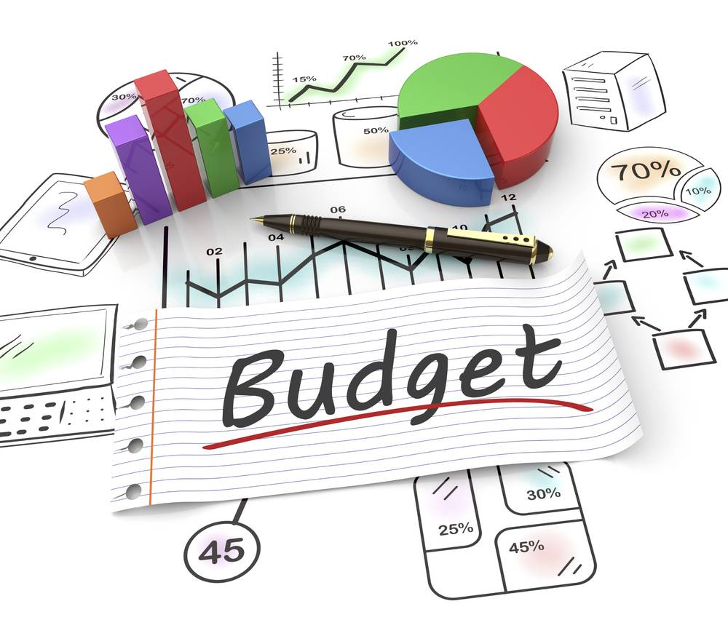
Nithin’s

Slide 2




Our Team
Laya Shree G
AF05054173
ANP-D1536
Manjula Dharamsoth
AF05059785
ANP-D1536
Madigiri Pushpa
AF05060171
ANP-D1536

Slide 3

Project Overview
Subject: Nithin's Personal Expenses.
Duration: January to June (6 Months).
Total Spend (6 Months): ₹84,390.
Key Categories: Grocery, Shopping, Ticket & Bills, Entertainment, Food, Doctor, Miscellaneous.
Expenses Analysis is parted into 2... Part 1 explains about Only June month Expenses and on other hand Part 2 explains about Jan-Jun expenses.

Slide 4
Nithin’s
Part 1

Slide 5

Part 1: Analysis of June Data (1 Month)
1.Category Breakdown
2. Specific Category Details
3. Item Frequency
Total Spent in June: ₹13,560
Top Categories:
Grocery: ₹4,690 (Highest)
Shopping: ₹3,500
Ticket and Bills: ₹2,570
Entertainment: Spent mostly on Movies (₹1000).
Tickets & Bills: Big expenses were House help (₹1000) and Electricity (₹370).
Grocery items were purchased most frequently (Vegetables, Fruits, Bread).

Slide 6

Executive Summary: June Financial Overview

Slide 7
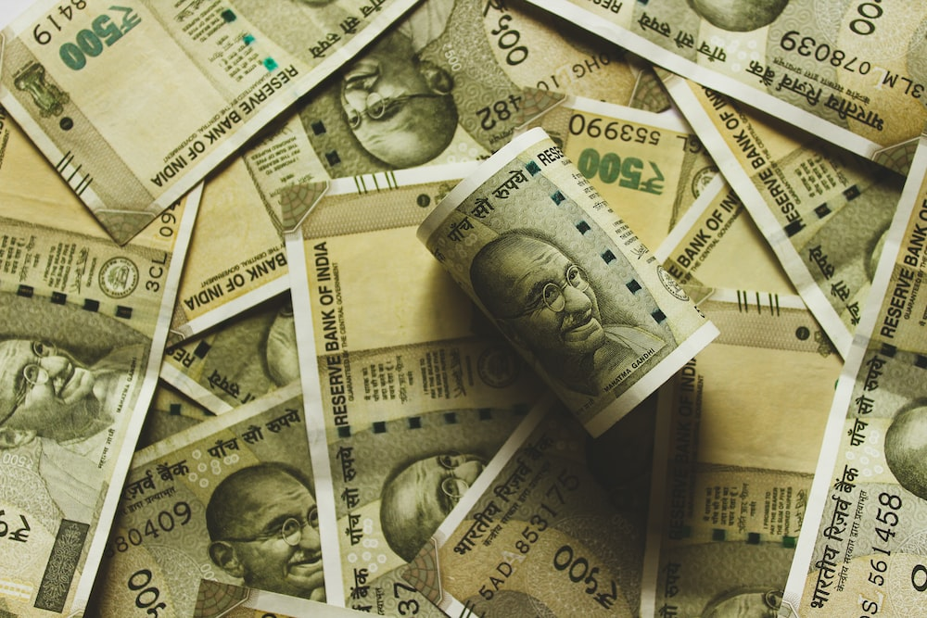
Top Spending Categories
Grocery: ₹4,690 (Highest expense, approx. 35% of total).
Shopping: ₹3,500 (Driven by clothing purchases).
Ticket & Bills: ₹2,570 (Recurring household bills).

Slide 8
High-Cost Line Items:
T-shirt and Jeans: ₹2,500 (Single largest purchase).
Vegetables: ₹1,690.
House Help: ₹1,000.
Food grains & Cereals: ₹1,050.

Slide 9
Key Observations:
Spending was heavily influenced by Grocery needs and a significant Shopping trip for clothes.
Entertainment (₹1,000) and Food/Dining (₹850) were kept relatively low this month compared to essentials.

Slide 10
Expense Distribution
Grocery is the dominant category, consuming 34.6% (₹4,690) of the total budget.
Shopping is the second largest at 25.8% (₹3,500), primarily due to clothing purchases.
Ticket and Bills accounts for 19.0% (₹2,570).
The remaining ~20% is split between Entertainment, Food, Miscellaneous, and Medical expenses.

Slide 11
Nithin’s
Part 2

Slide 12
Where Did the Money Go? (Category Distribution)
Insight: Essentials dominate the budget.
Grocery (36.7%) and Ticket/Bills (19.0%) combined account for over 55% of all expenses.

Slide 13
Monthly Spending Trend
Insight: Expenses are relatively stable around the ₹13k-14k mark. The spike in February (₹15.6k) was driven by travel, while March (₹13.1k) was the most disciplined month.
Category Breakdown by Month:
Grocery: consistently the largest bar every month.
Entertainment: Visible spikes in Feb (Trip) and May.
Shopping: Occurs periodically (Jan, Mar, June) rather than monthly.

Slide 14
Top 10 Expense Items
Vegetables (₹9,390) and Food grains (₹7,660) are the highest cumulative costs, showing the high cost of daily sustenance.
The North Bengal Trip (₹7,500) is the single largest one-time discretionary expense.
House Help (₹6,000) is a significant recurring service cost.

Slide 15
Executive Summary
1
2
3
4
5
Total Spending: ₹84,390
Average Monthly Spend: ₹14,065
Highest Spending Month: February (₹15,620)
Top Spending Category: Grocery (₹30,990 - 36.7% of total)
Most Expensive Item (Cumulative): Vegetables (₹9,390)

Slide 16
Path to Financial Health
1. Optimization Strategy (Reduce 'Needs' from 70% to 50%)
2. Stability Strategy (Manage Volatility)
3. Savings Goal
Bulk Purchase: Buy non-perishables (Rice, Oil, Pulses) bi-monthly to reduce the ₹31k Grocery bill by ~10%.
Audit Incidentals: Track the "Miscellaneous" category (₹8k) to plug unaccounted cash leaks.
Travel Sinking Fund: Save ₹1,500/month specifically for trips to prevent spikes like February (₹7.5k).
Impulse Control: Implement a "7-Day Wait Rule" for Shopping items >₹1,000 (e.g., Shoes/Clothes).
Current State: 0% dedicated Savings (Income consumed by Needs/Wants).
Target: Shift 20% of budget from "Essentials" and "Dining Out" into a Savings Fund.

Slide 17

"That concludes my analysis of the 6-month financial data. I hope these insights on our spending habits and the strategic recommendations for savings are helpful. I am now happy to answer any questions you might have or revisit any specific charts."

